Slide 1
Safety and inspection and testing
PowerPoint presentation
Unit 304: Electrical Installations: inspection, testing and commissioning

Slide 2
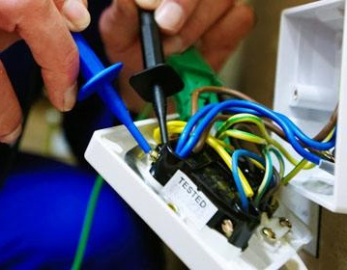
It is a requirement that new installations are inspected and tested during commissioning as part of the initial verification process to ensure that they are safe to bring into service
Existing installations must be periodically inspected and tested to ensure that they are safe to continue in service.

Slide 3
Whether carrying out an initial verification or a periodic inspection then all possible health and safety procedures must be followed at all times.
Working on any electrical installation carrying out a safe isolation is key to ensuring health and safety both for you and others affected by your work activity.

Slide 4
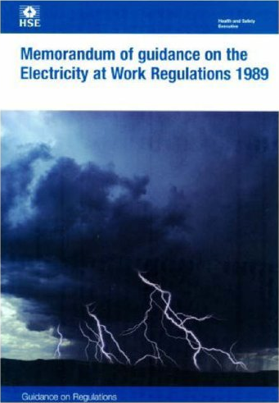
Regulatory requirements
Electricity at Work Regulations 1989
The Electricity at Work Regulations 1989 (EAWR) places a legal responsibility on employers and employees, as duty holders, to ensure that electrical systems used at work under their control are safe.
To achieve compliance with the legal requirements of the Electricity at Work Regulations 1989 requires proof that an electrical system is safe, which involves among other things, proper inspection and testing of a system by competent people and the creation and maintenance of records.

Slide 5
Regulatory requirements
Electricity at Work Regulations 1989
Regulations 1–3 are the Introduction covering citation and commencement, interpretation and persons on whom duties are imposed by these regulations.
Regulations 4–16 are the general regulations
Regulations 17–28 are for mines only.
Regulations 29–32 are miscellaneous and general.

Slide 6
Safe isolation
This must be carried out to prevent danger to yourself and others. If a full isolation procedure is not carried out, risks may be introduced as follows:
To yourself: risk of electric shock or burns due to contact with the wiring system.
To co-workers: risk of contact with electrical parts when basic protection has been removed
To customers/clients: risk of shock or burns or damage to equipment attempting to use the system
To the public: risk of shock or burns due to lack of awareness of potential danger
To building systems: risk of damage to electrical equipment and/or building fabric and loss of services.

Slide 7
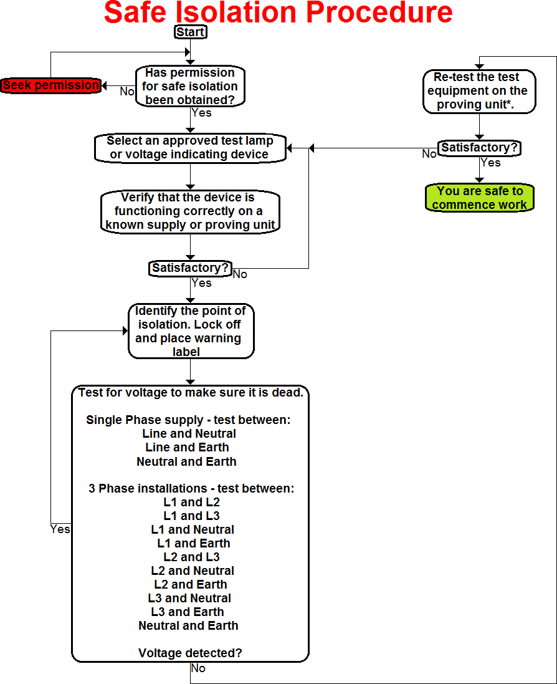

Slide 8
Health and Safety requirements
The Health and Safety requirements which apply when inspecting, testing and commissioning electrical installations and circuits are:
Working in accordance with risk assessments / permits to work / method statements
Safe use of tools and equipment
Safe and correct use of measuring instruments
Provision and use of PPE
Reporting of unsafe situations.

Slide 9
Dealing with clients
When dealing with clients you need to ensure the following:
Ensuring the safety of others during the work activities
Keeping clients informed during the process
Labelling electrical circuits, systems and equipment that are still to be commissioned
Providing clients with all the appropriate documentation upon work completion.

Slide 10
Any questions?

